Slide 1







Mutual Fund Plan Analyzing Nifty50: High Returns, Low Risk
by Samrat Saha
Page 1

Slide 2


Problem Statement
The goal is to develop a Mutual Funds Investment Bucket that is optimized for long-term investments by balancing risk and returns. This involves selecting companies that provide consistent growth and moderate returns while minimizing exposure to volatility. Specifically, the objectives are:
Stock Selection: Identify stocks with high ROI and low volatility, which will form the core of the mutual funds portfolio
Performance Evaluation: Use metrics such as volatility (standard deviation) and expected ROI to assess which stocks are optimal for inclusion in the portfolio
Investment Strategy: Simulate the expected future value of investments based on monthly contributions over different time horizons (e.g., 1 year, 3 years, 5 years, and 10 years)
Risk-Reward Balance: Develop a strategy that ensures a balance between risk and reward, targeting long-term investors who seek stable, compounded growth over several years
Page 2

Slide 3
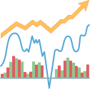
Data Overview
The dataset consists of daily closing stock prices of 50 major Indian companies from sectors like banking, technology, consumer goods, and automotive. Each company is represented by a ticker symbol (e.g., RELIANCE.NS, ICICIBANK.NS), and the dataset includes the following features:
Date: The date on which the stock price is recorded.
Closing Price: The adjusted closing price for each stock on that particular date
Companies: A total of 50 top Indian companies are represented, covering a range of sectors like banking (HDFC Bank, ICICI Bank), technology (TCS, Infosys), consumer goods (Hindustan Unilever, ITC), automotive (Tata Motors, Bajaj Auto), and others
Page 3

Slide 4

Methodology
A mutual fund plan is created by selecting the stocks where an investor can benefit in the long term. Here’s the process we can follow to create a mutual fund plan:
Step 1: Gather historical stock data, such
as closing prices and growth trends over time
Step 2: Calculate key metrics like Return on Investment (ROI) and volatility (risk) to understand
how each stock has performed historically
Step 3: Choose stocks that have a high ROI and low volatility to ensure a balance between risk and reward
Step 4: Calculate the future value of monthly investments based on the expected ROI of the selected stocks
Page 4

Slide 5
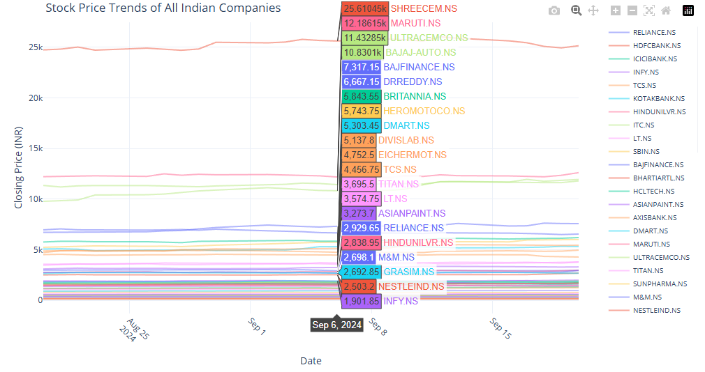
Stock Price Trends of All companies of Nifty 50
Page 5

Slide 6
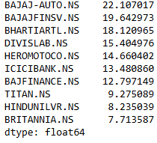
Companies with Highest ROI
Page 6

Slide 7
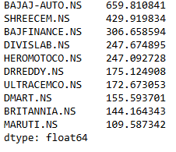
Companies with High Risk(high volatility)
Page 7

Slide 8
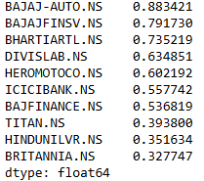
The companies with the highest growth rate
Page 8

Slide 9
Top Mutual Fund Picks based on ROI and Volatility comparison
Rank | Company | ROI (%) | Volatility
1 | BAJAJ-AUTO.NS | 22.11 | 1.55
2 | BAJAJFINSV.NS | 19.64 | 1.37
3 | BHARTIARTL.NS | 18.12 | 1.34
4 | DIVISLAB.NS | 15.40 | 1.46
5 | HEROMOTOCO.NS | 14.66 | 1.09
6 | ICICIBANK.NS | 13.48 | 1.16
7 | BAJFINANCE.NS | 12.80 | 1.58
8 | TITAN.NS | 9.28 | 1.25
9 | HINDUNILVR.NS | 8.24 | 1.21
10 | BRITANNIA.NS | 7.71 | 0.93
To create a strategy for selecting companies with high ROI and low risk, we can use a combination of ROI and volatility (standard deviation) metrics. The goal is to find companies that offer a high return on investment (ROI) but with low volatility to minimize risk
Page 9

Slide 10
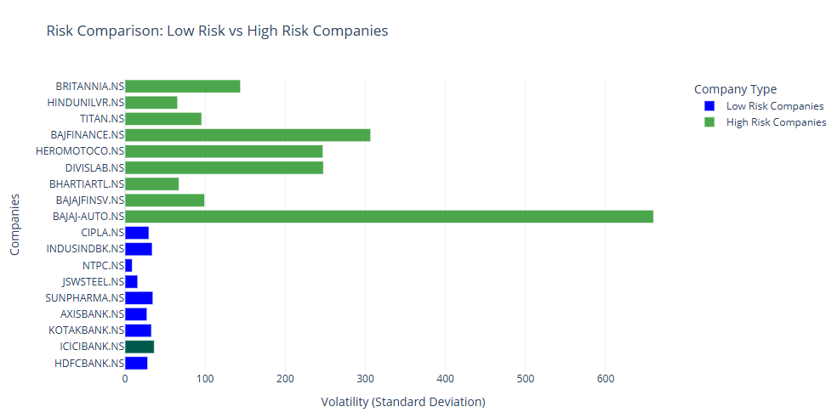
Risk Comparison
We have created a mutual fund plan for long-term investments. Now, let’s analyze and compare our mutual fund plan by comparing it with the high-performing companies in the stock market
Page 10

Slide 11
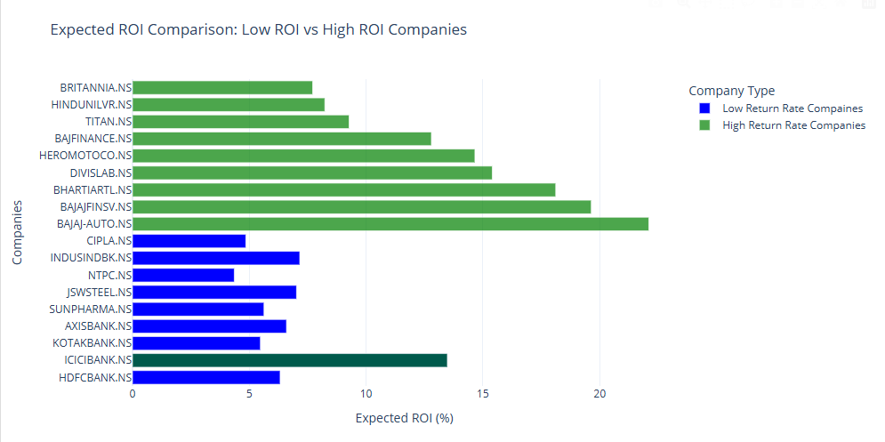
Expected ROI comparison
The comparison between the risk (volatility) and expected ROI for mutual fund companies (in blue) and growth rate companies (in green) shows a clear trade-off. Mutual fund companies offer lower volatility, meaning they are less risky, but also provide lower expected returns. In contrast, growth rate companies demonstrate higher volatility, indicating more risk, but they offer much higher potential returns, especially companies like Bajaj Auto and Bajaj Finserv. This highlights a common investment dilemma: lower risk comes with a lower reward, while higher risk could yield higher returns
For long-term investments, the goal is typically to find companies that offer a balance of stable returns and manageable risk. The companies in our mutual fund exhibit low volatility, meaning they are less risky, and their moderate returns make them solid choices for long-term, stable growth. They are well-suited for conservative investors who want steady returns without significant fluctuations in value.
Page 11

Slide 12
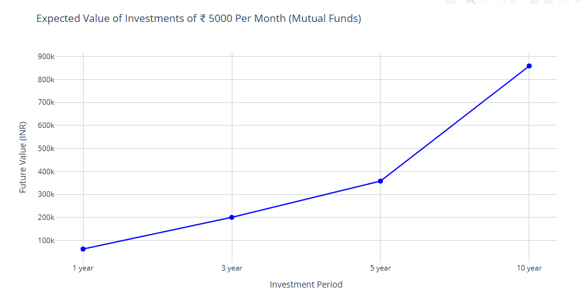
Insights & Recommendations
Now, let’s calculate the expected returns a person will get from our mutual fund if he/she invests ₹5000 every month
To calculate the expected value a person will accumulate over 1 year, 3 years, 5 years, and 10 years through the mutual fund plan, we can follow these steps:
Assume the person is investing 5000 rupees every month
Use the expected ROI from the mutual fund companies to simulate the growth over time
Compute the compounded value of the investments for each period (1y, 3y, 5y, and 10y)
Visualize the accumulated value over these periods
After 1 year, the accumulated value is around ₹62,000, and by 5 years, it grows to over ₹300,000. The long-term benefit is evident, with the investment growing to nearly ₹860,000 over 10 years, which emphasises the value of consistent investing and compounding over time for long-term investors
Page 12

Slide 13
Conclusion
How to these Insights are useful
Informed Investment Decisions
The ROI and volatility analysis helps identify high-performing yet stable stocks for more strategic mutual fund allocation
Risk Management Optimization
Selecting companies with lower volatility ensures the portfolio is resilient against market fluctuations
Personalized Fund Planning
Investors can tailor monthly SIPs (like ₹5000/month) based on projected returns, aligning with their financial goals
Scalable Strategy for Other Indices
The data-driven selection process can be applied to other indices (e.g., Nifty 100, BSE Sensex) for broader fund planning
Stakeholder Confidence & Transparency
Visual analytics and clear selection criteria build trust with clients, managers, and other non-technical stakeholders
Page 13

Slide 14
Thank You
Page 14

